Slide 1
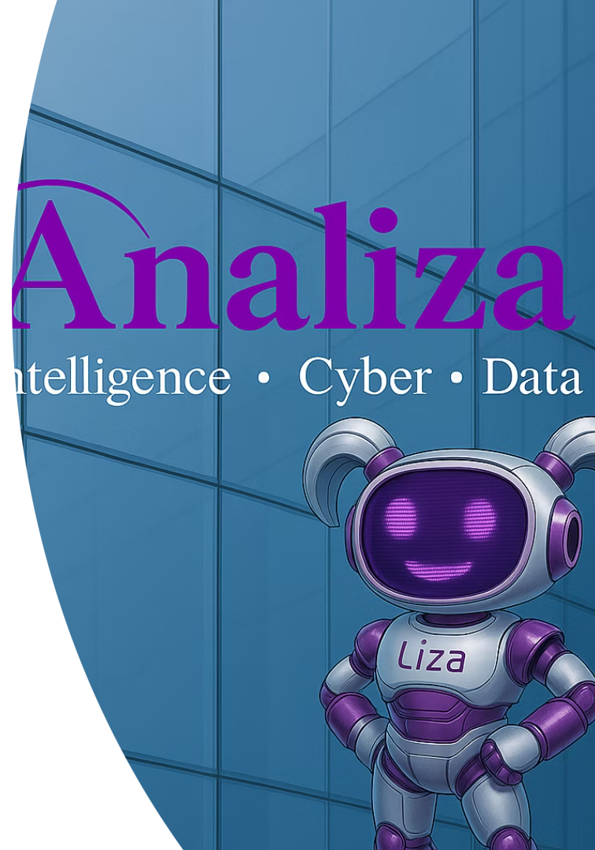

Introduction to 'Vibe Coding'

Slide 2
Agenda
From Traditional Development to No-Code Tools
From No-Code Tools to ‘Vibe Coding’ - AIs coding revolution
‘Vibe Coding’ Tools
In this Course - Prototype & Deployment

Slide 3
From Traditional Development
to No-Code Tools

Slide 4
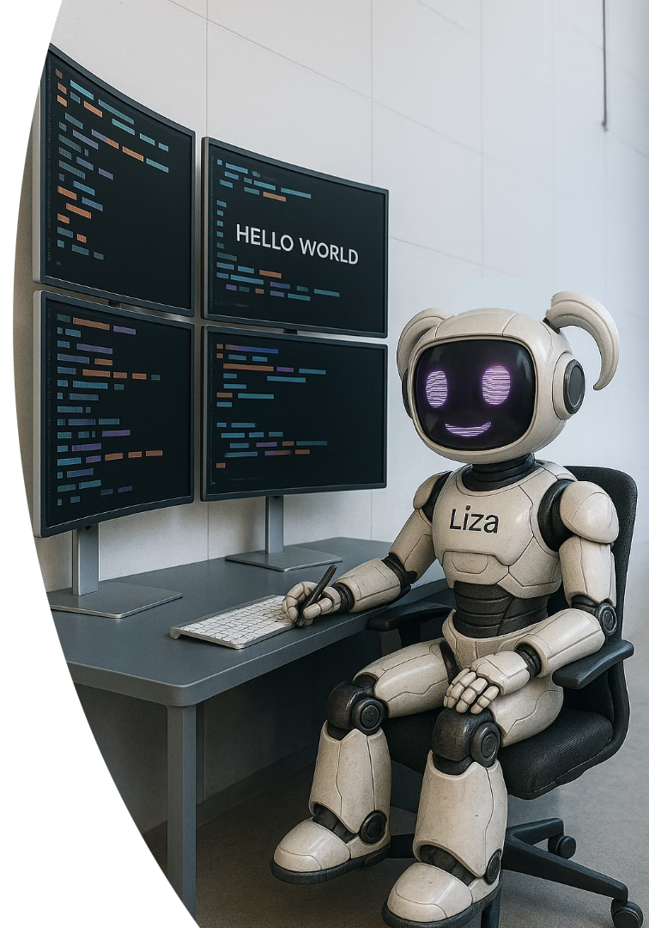
What is Traditional Development?
Writing software manually using programming languages (Python, JavaScript, Java, etc.).
Requires programing knowledge of:
Syntax, logic, data structures, and architecture
DevOps, version control (Git), and testing frameworks.
Involves:
Designing and coding from scratch.
Allows full control over front-end, back-end, and infrastructure.

Slide 5
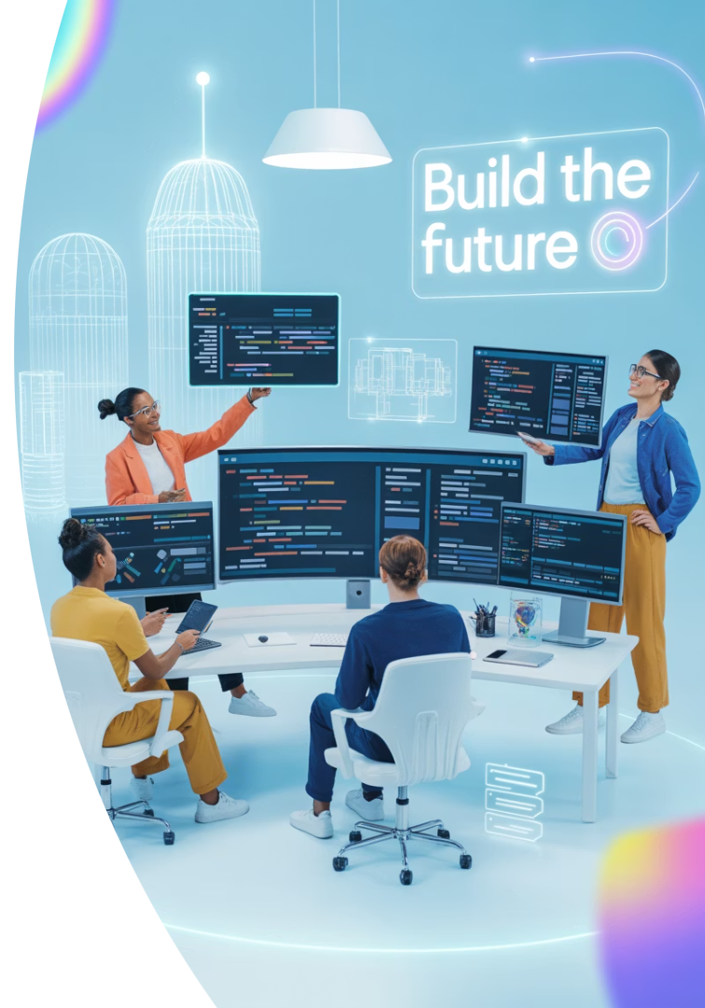
Traditional Development - Pros & Cons
Pros:
Full Control
Good for complex systems, scalable architectures, and security-sensitive apps.
Deep Debugging
Cons:
Longer Time to Market
Higher Costs
Resource Intensive
Slower Prototyping and less Agility
Limited to experts only
Notes:
PROS:
Full Control - Complete control over logic, performance, and integrations
Better Suited For - Complex systems, Scalable architectures, Security-sensitive apps
Deep Debugging - Advanced debugging tools (e.g., logs, breakpoints, test suites)
CONS:
Longer Time to Market - Traditional development involves manual coding, testing, and debugging, which leads to slower iterations and delayed deployments.
Higher Costs - It typically requires hiring skilled developers, leading to increased labor and maintenance expenses.
Resource Intensive - need developments and multiple specialists such as backend, frontend, and QA engineers, making the process complex and resource-heavy.
Slower Prototyping and less Agility - Building and testing new features or prototypes takes longer, delaying user feedback and product refinement.
Limited to experts only - Non-technical stakeholders cannot easily contribute, and business logic remains locked in the hands of developers.

Slide 6
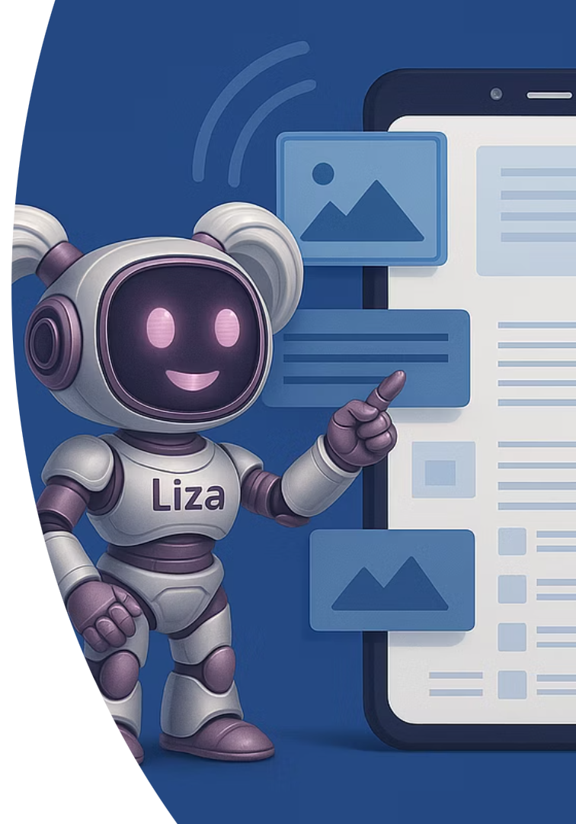
What is No-Code?
Definition: No-code platforms abstract away code through visual representations of logic, state, and UI.
A development approach enabling software creation without writing traditional code.
Uses visual interfaces, prebuilt modules, and workflows.
Allows users to drag-and-drop UI components, define logic with visual rules, and connect to data sources/API services without scripting.
Targets users with minimal or no programming background.
Common Example: Wix for website building

Slide 7
No-Code Building - Key Characteristics
Visual Interfaces
Logic Blocks
Component Reuse
Tools like flowcharts or form builders replace coding environments.
Conditional logic and loops handled through pre built modules.
Templates, design systems, and reusable blocks accelerate development.
Backend Integration
Cloud Deployment
Built-in or pluggable services for data storage, APIs, and third-party tools.
Apps are often hosted automatically via the platform.

Slide 8
From No-Code Tools to Vibe Coding

Slide 9



What is Vibe Coding?
Definition: Using LLM transformative conversational power and coding skills for building apps by describing what you want!
Think of Sketching an app or describing its behavior in words — and the system handles the translation into logic/code.
A new programming paradigm
Focused on intuition, visual thinking, and flow over syntax and strict logic.
Modern context
Coined in the context of no-code/low-code + AI-assisted development.
Natural building
Encourages building based on natural language, spatial logic, and creative iteration. No-code tools wrap LLMs to let you design and test workflows quickly.
Notes:
בסיום ההסבר - לעבור לקלוד ולהדגים איך זה נראה:
אני מבקשת ממנו לבנות לי איזשהו דף אינטרנט כשאני רק מספרת לו את הרעיון, והוא כותב את הקוד ומציג לי את ה-preview לדף הזה.

Slide 10
No Code vs Vibe Coding
Aspect
No Code
Vibe Coding
Interface
Visual drag-and-drop
Natural language + AI-powered code generation
User Base
Non-technical users
Developers & technical creators
Flexibility
Limited by platform constraints
Highly flexible with AI-assisted logic
Learning Curve
Very low
Low-to-medium (some coding knowledge helps)
Output Quality
Abstracted, often less customizable
Custom, developer-quality output
Main Tools
Webflow, Bubble, Zapier
Cursor, Replit, GPT-based IDEs

Slide 11




The Revolution -
Democratization of Software Creation!
These tools allows broader participation in building digital products! The focus - writing good prompts..!
Entrepreneurs & Startups
Product Designers & PMs
Individual Users
Personal tools.
MVP development without hiring dev teams.
Quick iterations and UI/UX validation.
Notes:
מה שחשוב כאן הוא לא לדעת לקודד אלא לדעת לנסח פרומפטים טובים, לחדד כוונה ולכוון את הבינה המלאכותית.
מאפשר לכולם לבנות, בלי שום רקע טכני.

Slide 12
‘A Day in Life’ of a Vibe Coder
💡 Spark Stage
⚙️ Live Feedback Loop
🧪 Feel Tuning
Sketch the idea -
Start with a raw concept / Drop a thought into Canvas / draft a quick UI sketch.
It’s all about capturing the spark and visualize your app idea!.
Test in real-time -
Immediately run prompts, logic, and UI updates.
Feedback flows instantly, so you can adjust on the fly.
Refine the output by adjust the prompt, flow, or interface until the tool is what you want.
“If it clicks, it's right.”
🤖 Co-Creation Mode
🚀 Flash Deploy
Build with AI -
Use AI not just for writing code, but for iterating UI, refining copy, optimizing prompts, and brainstorming edge cases — like a creative partner.
Ship fast -
Turn your prototype into something shareable (a link, a demo, or even a live product!) in hours, not days.

Slide 13
Real-World Scenario Comparison
🔧 Scenario: Build an internal AI-powered content assistant
Criteria
Traditional Development
No-Code/Vibe Coding Development
Time to MVP
3–5 weeks (setup, frontend, API, auth)
2–3 days (Base44 + ChatGPT Canvas)
Required Roles
Backend + frontend dev, designer
One builder with prompt + logic skills
Flexibility
Full customization
Limited but fast
Maintenance
Needs dev attention
Mostly automated

Slide 14
Pros of Vibe Coding Tools
Speed
Build and iterate 5–10× faster than traditional coding.
Lower Barriers to Entry
No prior coding experience required.
Reduced Costs
Fewer developers needed = lower dev budgets.
Rapid Prototyping
Useful for quick feedback and early validation.
Built-in Scalability (to a point)
Some platforms support scaling to moderate traffic.
Natural Language Interfaces
Use plain English to create logic, workflows, or content.
Creative Flexibility
Blend logic, design, and storytelling using intuitive tools and AI.
Human-AI Collaboration
Co-create with LLMs to build smarter, more adaptive systems.
Faster Ideation-to-Execution Flow
Go from idea to output without detailed specs or manual coding.

Slide 15
Cons of Vibe Coding Tools
Limited Customization
1
No-code platforms often restrict access to lower-level code, limiting the ability to implement highly customized features.
2
Scalability Issues
Applications may struggle to handle large-scale users, complex workflows, or data-heavy operations efficiently.
Vendor Lock-In
3
You're often tied to the specific platform's infrastructure, pricing, and limitations, making migration difficult.
4
Security Concerns
Security and compliance are managed by the platform, which may not meet the requirements of all industries or use cases.
Integration Limitations
5
Third-party integrations can be limited or less flexible compared to custom code solutions.

Slide 16
When to Use What?
Purpose | Optional Platforms | Complexity Level
Simple web pages | Chat GPT (canvas feature) Gemini (canvas feature) Claude (artifact feature) | simple
Prototype an idea | Chat GPT (canvas feature) Gemini (canvas feature) Claude (artifact feature) | simple
Lightweight fully functional web applications | Base44 Lovable Bolt | medium
Free programing with AI | Cursor, Windsurf | high (require programming skills and background)

Slide 17
In this Course you will:
Create custom web-pages
Prototype your idea
Deploy your idea to become a fully functional app

Slide 18

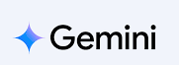
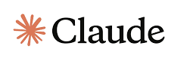
Custom web-pages and Prototyping your ideas
canvas feature
canvas feature
artifact feature

Slide 19
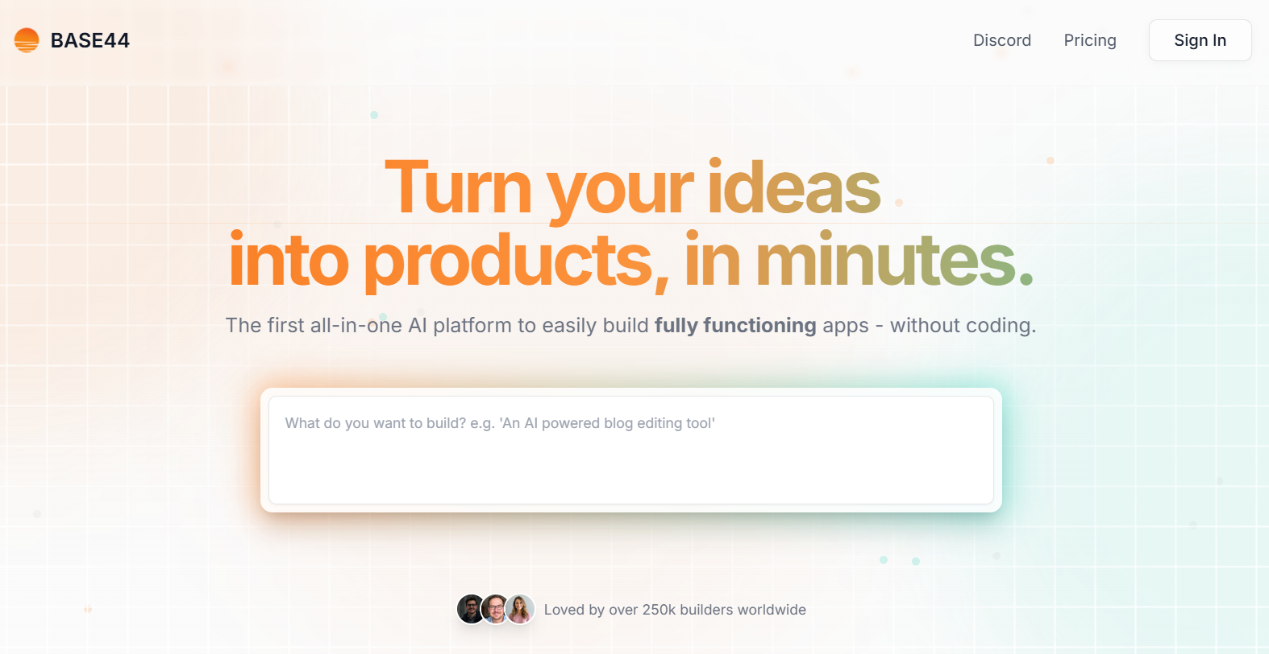
Deploy your idea via Vibe-Coding platform

Slide 20
Summary
From Traditional Development to No-Code Tools
From No-Code Tools to ‘Vibe Coding’
Vibe Coding Tools
In this Course - Prototype & Deployment

Slide 21
Questions?

